Slide 1
Image Processing: Image Compression Techniques
Dr. Bhakti Nilesh Palkar
Associate Professor at K J Somaiya School of Engineering
Presentation by:
Kashish Mehul Mamania
TY COMPS-A(3)
16010122104

Slide 2
Introduction
Image compression is a method to reduce the redundancies in image representation in order to decrease data storage requirements.
It is a technique used to compress an image without visually reducing the quality of the image itself.
Data vs. Information.
The goal of these processes is to represent an image with the same quality level, but in a more solid form.

Slide 3
Why the image must be compressed?
The large storage requirement of multimedia data.
The video or image files consume large amount of data and it always required very high bandwidth networks in transmission as well as communication costs.

Slide 4
Aims of Image Compression
Reduce the data storage and maintain the visual image quality.
Increase the speed of transmission by using the repetition property of data.
The goal of these processes is to represent an image with the same quality level, but in a more solid form.

Slide 5
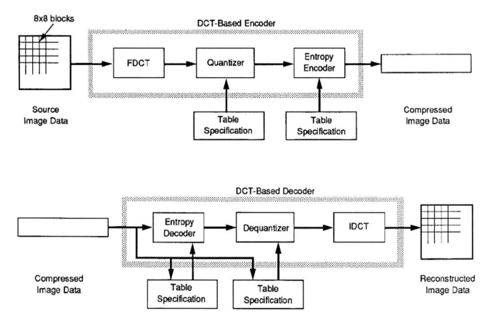
General Image Compression Model

Slide 6
Image Compression (Encoder)
Image Transformation
Image Quantization
Entropy Coding
AC Huffman Table
Zig-zag Reordering
Huffman Coding
Color components (Y, C_{b}, C_{r})
Scalar Uniform Quantization
8x8 DCT Transform
Bit-stream
Difference Encoding
Huffman Coding
Quantization Table
DC Huffman Table

Slide 7
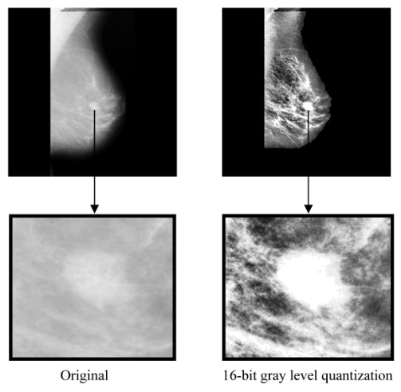
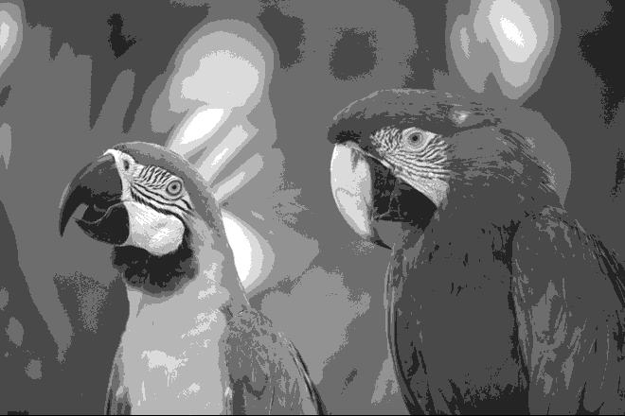
Improved Grey Scale Quantization
Concept: Reduces graininess and false contouring in compressed images.
Process:
Adds lower bits of neighboring pixels to smooth transitions.
Prevents overflow issues during quantization.
Applications:
Enhances visual quality in compressed images.

Slide 8
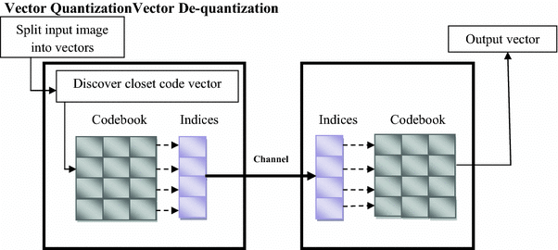
Vector Quantization
Concept: Maps blocks of pixels (vectors) to a smaller set of quantized values using a codebook.
Advantages:
High compression ratios (e.g., 16:1).
Efficient representation of smooth gradients.
Applications:
Speech and image compression systems.

Slide 9
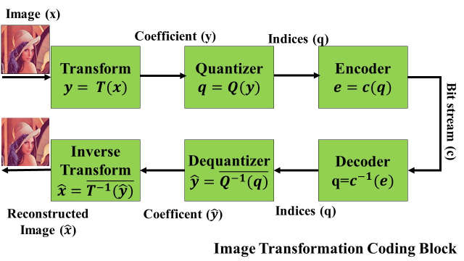
Transform Coding
Concept: Converts spatial image data into frequency components using transforms like Discrete Cosine Transform (DCT).
Process:
Divide image into 8×8 blocks.
Apply DCT to each block.
Quantize frequency components selectively.
Applications:
Used in JPEG compression for efficient storage and transmission.

Slide 10
JPEG Compression
Steps in JPEG Compression:
Convert image into YCbCr color space.
Divide image into 8×8 blocks and apply DCT.
Quantize DCT coefficients using predefined tables.
Zigzag reordering groups low-frequency coefficients together for efficient encoding.
Apply entropy coding (Huffman or Arithmetic).
Modes of JPEG:
Sequential Mode: Encodes image in a single scan.
Progressive Mode: Transmits coarse versions first, then refines gradually.

Slide 11
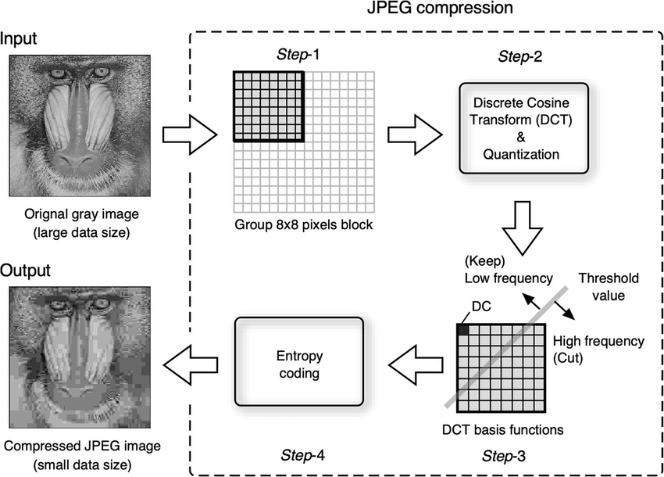

Slide 12
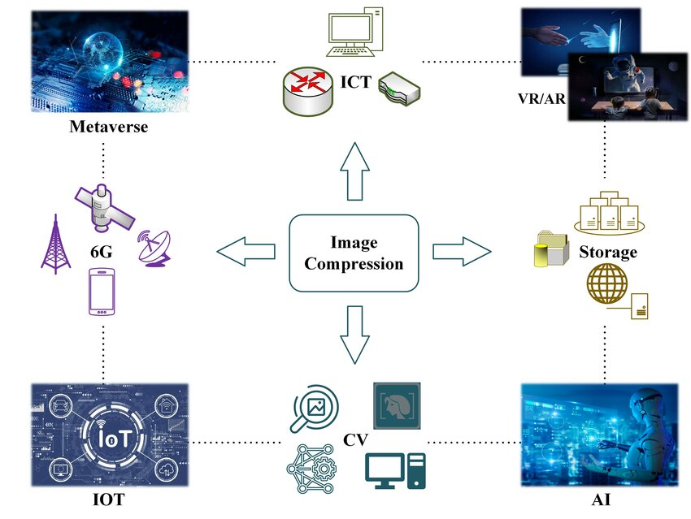
Applications of Image Compression
Medical Imaging: Lossless methods preserve diagnostic accuracy.
Web Graphics: JPEG enables faster loading times with minimal quality loss.
Photography Archives: Lossless formats for master copies; lossy formats for distribution.

Slide 13
Conclusion
Image compression techniques balance file size reduction with acceptable visual quality loss.
Improved Grey Scale Quantization, Vector Quantization, Transform Coding, and JPEG are widely used methods for lossy compression.
Applications span diverse fields like healthcare, multimedia, and communication systems.

